Slide 1
BAMA 520 Customer Analytics
Assignment 1
Group 17
Ms.Xing
Ms.Wang
Mr.Zhao
Zhao Zhang

Slide 2

Tableau Visualization of Airbnb in
New York

Slide 3


Executive Summary
Tableau Interactive Visualization of Airbnb Listings in New York (2009 - 2019)
Summary Statistics
Geographic Overview
Key Locations Comparison
Rank of Hosts
Demand Estimate
Times Series Analysis

Slide 4

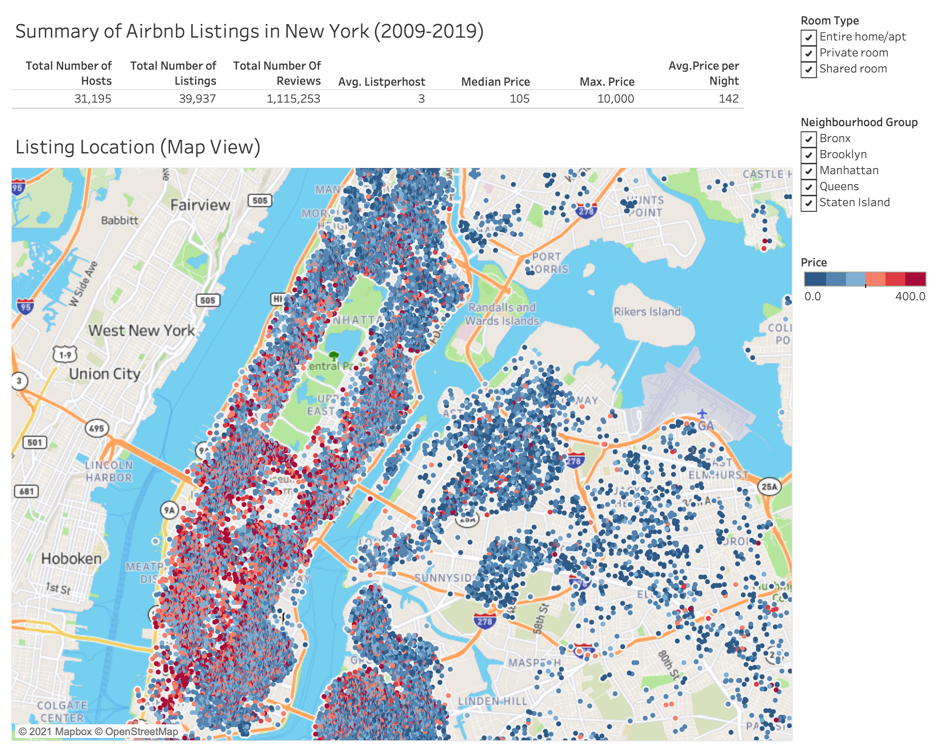
Q1 Summary Statistics

Slide 5

Q2 Geographical Overview
Airbnb listings are augmented to a NYC map with price level indicated by the shift of colour scheme in six steps
Price range is displayed between $0 - $400 to represent most listings
Information of Price, Room Type, Neighbourhood, Neighborhood Group, and Number of Reviews are displayed when listing is hovered

Slide 6

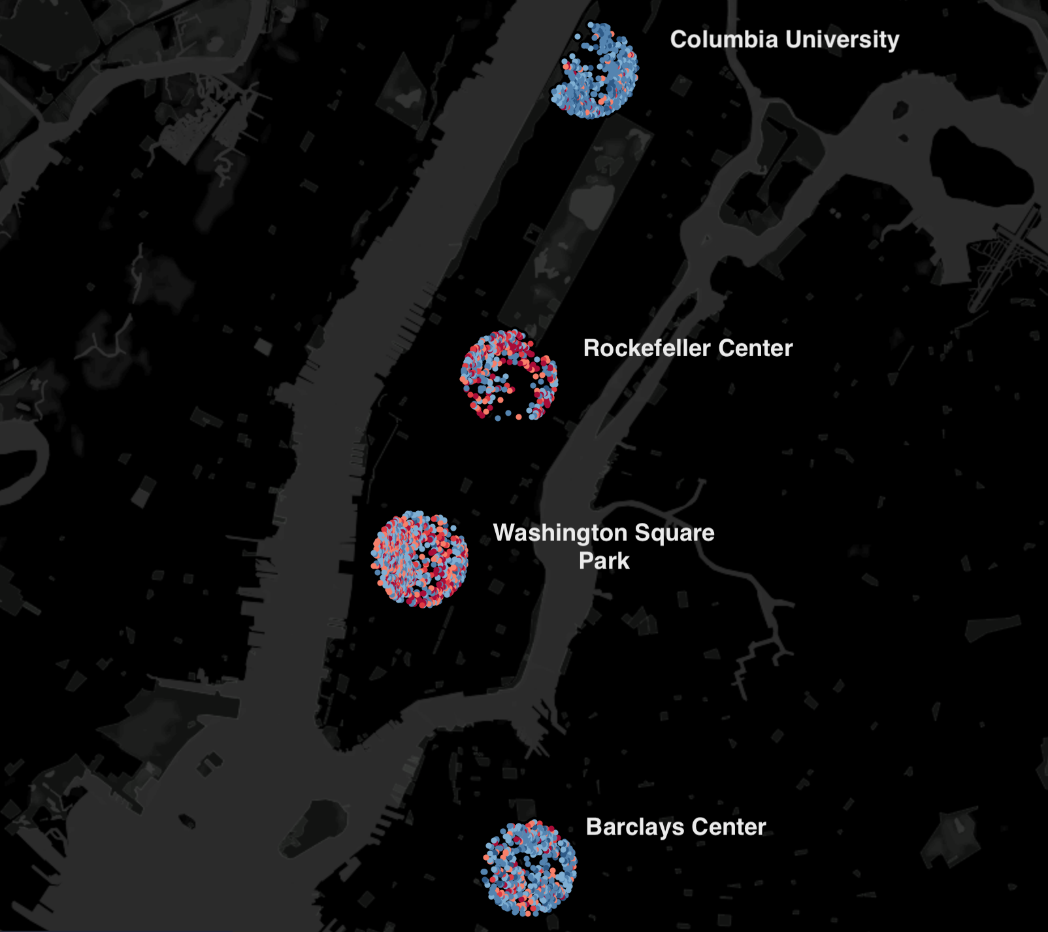
Q3 Key Locations
Comparison between 4 key locations in NYC
(* circle radius = 0.5 miles)
Columbia University
Rockefeller Center
Washington Square
Barclays Center

Slide 7

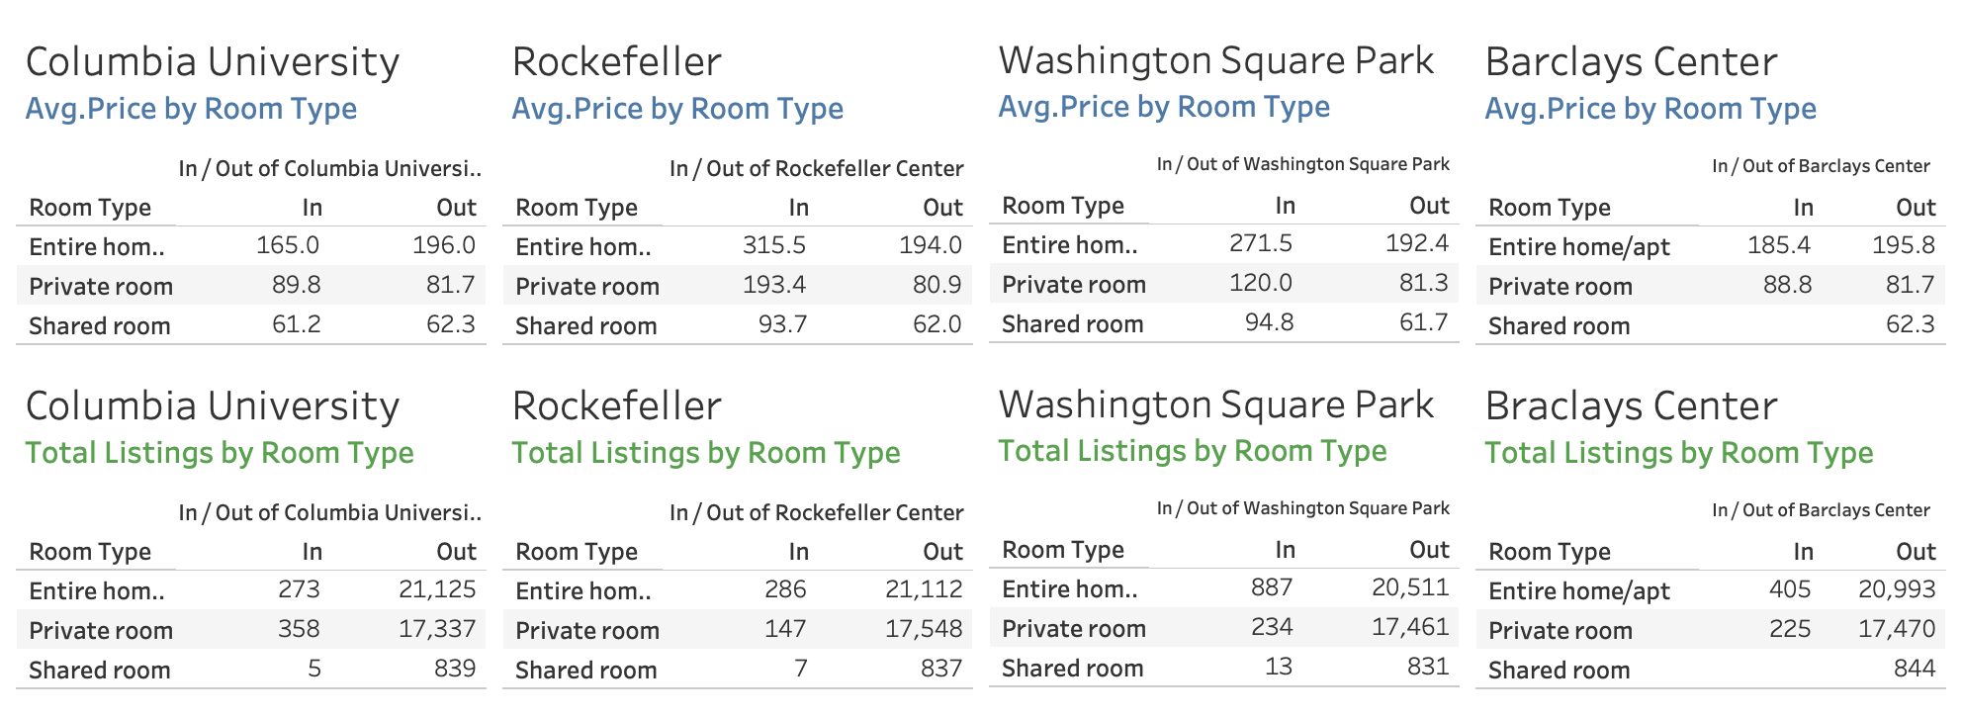
Q3 Key Locations
Includes Average Price and Total Listings for each Key Location by Room Type

Slide 8


Q4: Hosts Rank
We rank the host by average number of reviews per listing to provide an overview on the average quality of service / engagement level of the hosts across New York City.
Average number of reviews is also easily accepted as a proxy for demand / popularity
Note that the assumption on how number of reviews indicate higher quality of service can be easily violated (e.g., leaving a bad review after an unpleasant experience)

Slide 9
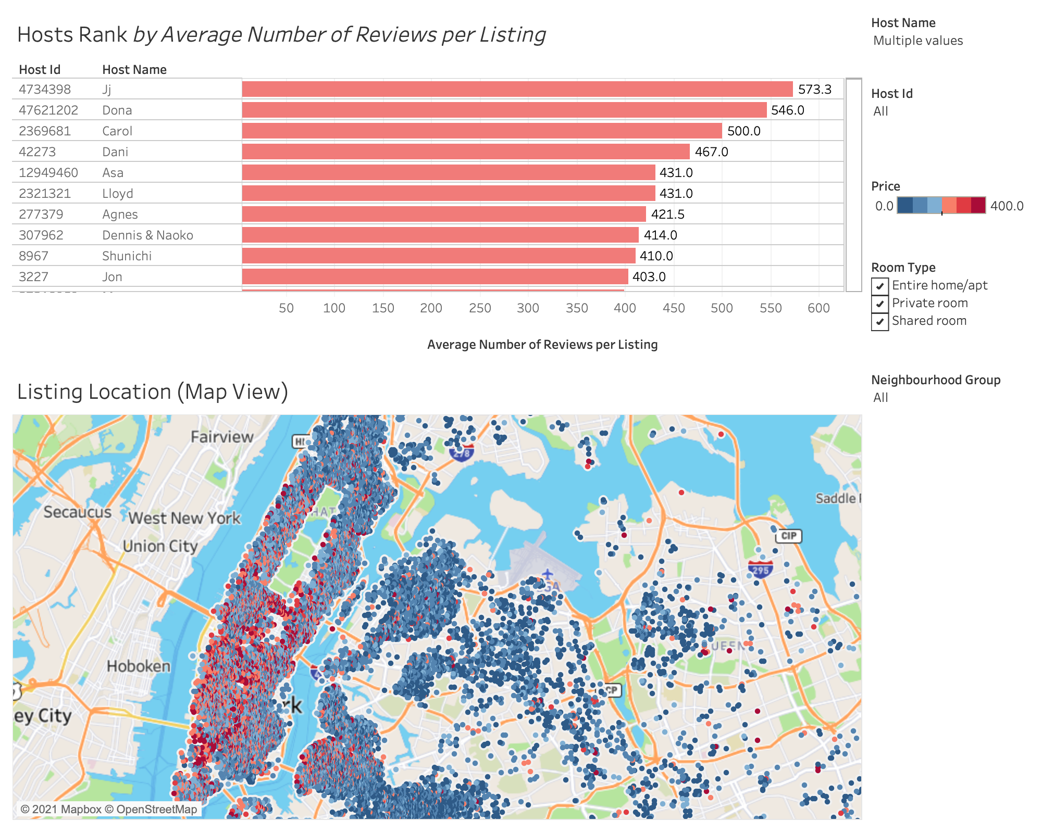

Slide 10

Q5: Demand Estimate
Assumption and Explanation:
The number of reviews per listing is adopted to indicate the demand.
According to research, 70% of Airbnb guests leave reviews¹. Therefore, as the number of bookings is not provided, the number of reviews per listing is a good approximation to of Airbnb demand.
Price and demand reviews per listing are both logged
allow us better interpret the change in demand for every 10% increase in prices.
Overall Demand Analysis:
In this case, we only have one explanatory variable. As demand is normally explained by more than one variable, it is not significant to analyze the overall demand.
Instead, we will analyze demand by clustering price for each room type
Notes:
1.2012, A. (2020, May 11). 5 Tips to 5-Star Airbnb Reviews ● OptimizeMyBnb.com. Retrieved January 24, 2021, from https://optimizemybnb.com/5-tips-5-star-airbnb-reviews/

Slide 11
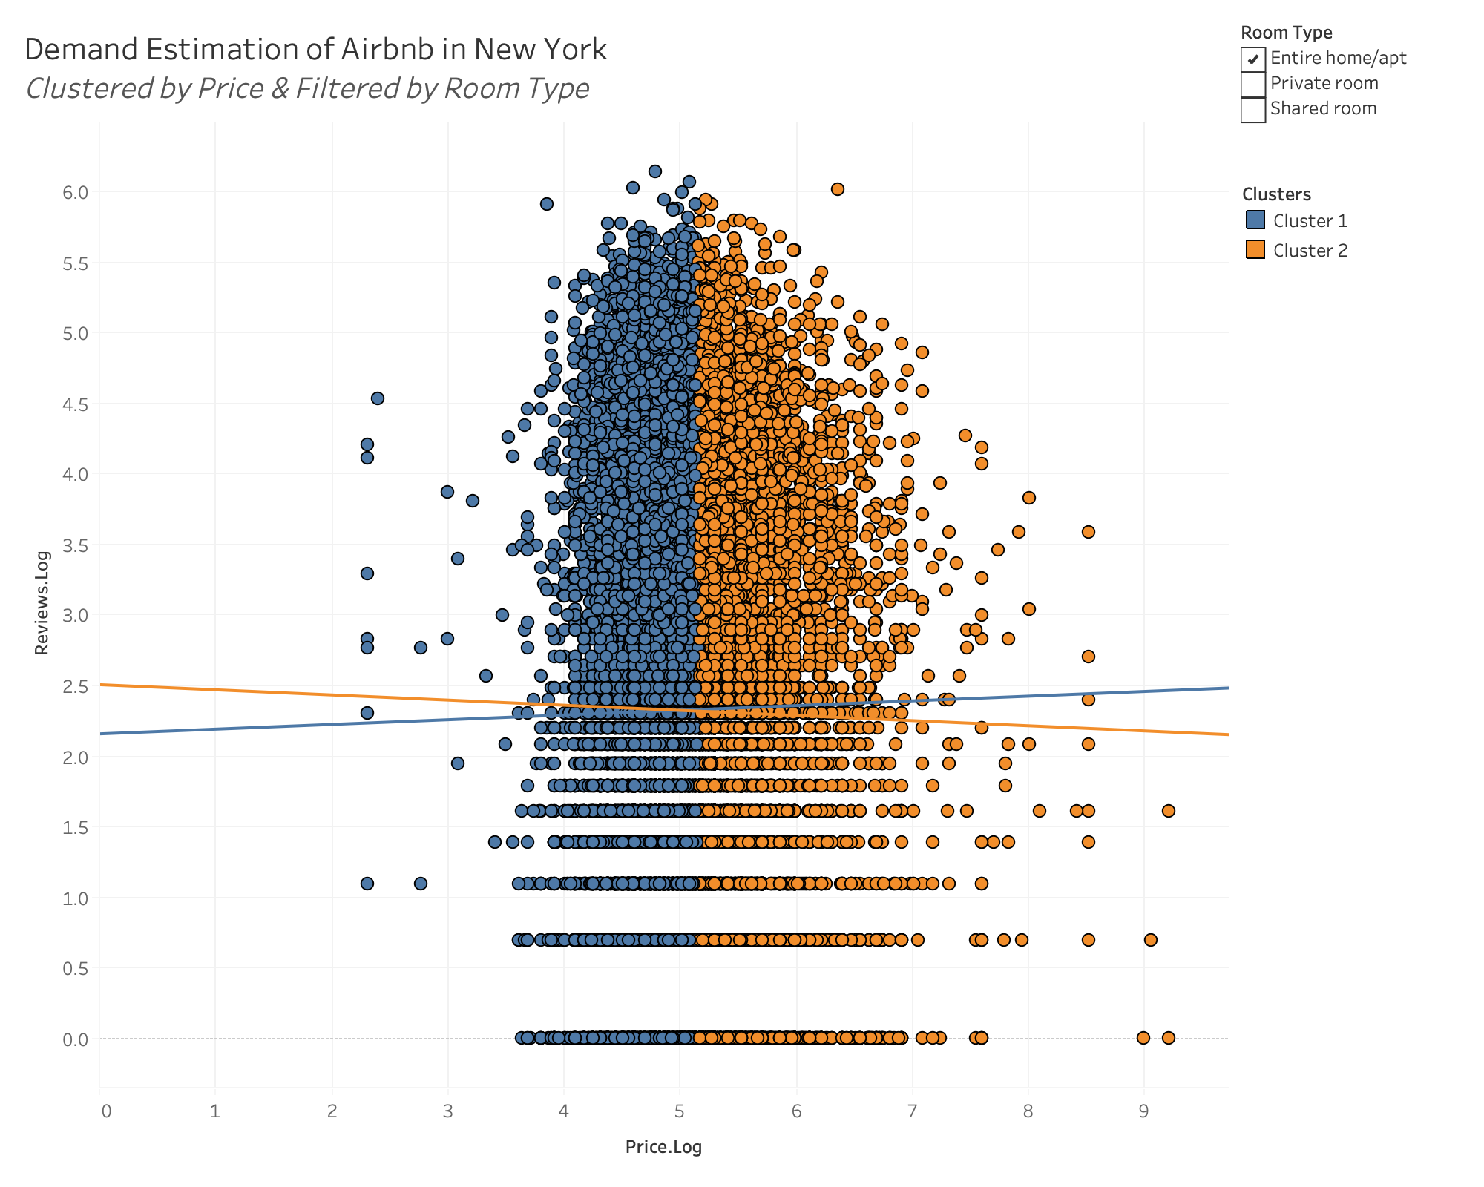
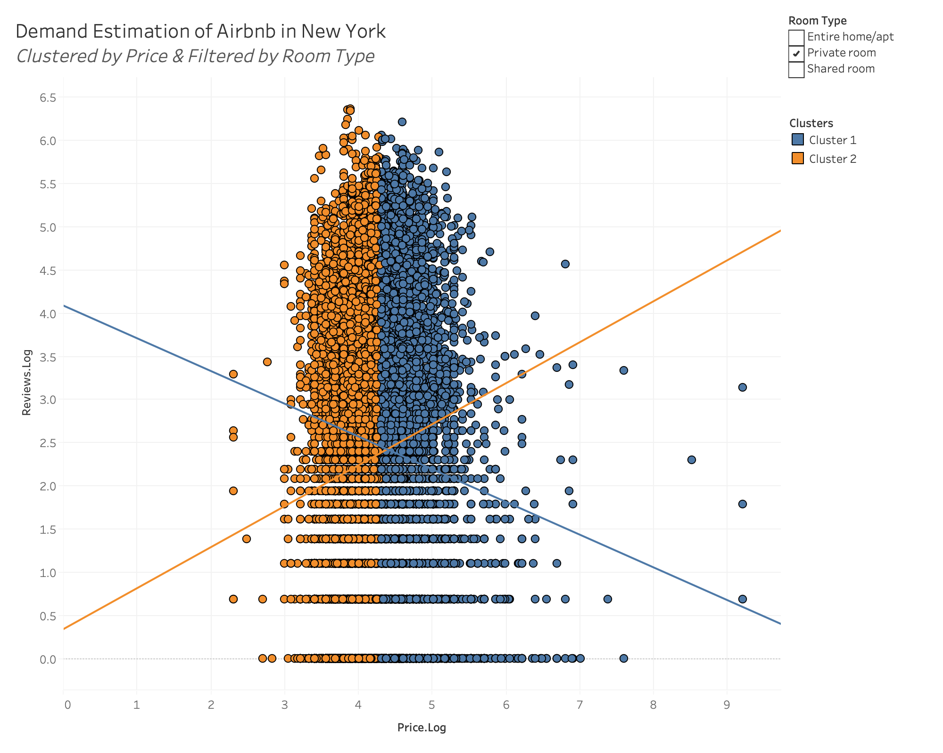
Q5: Demand Estimate based on Room Type
Entire home/apt:
Price.log below 5
As price increases by 10%, the demand of Airbnb increases by 0.334%.
Price.log above 5
As price increases by 10%, the demand of Airbnb decreases by 0.364%.
Private Room:
Price.log below 4
As price increases by 10%, the demand of Airbnb increases by 4.747%.
Price.log above 4
As price increases by 10%, the demand of Airbnb decreases by 3.791%.

Slide 12
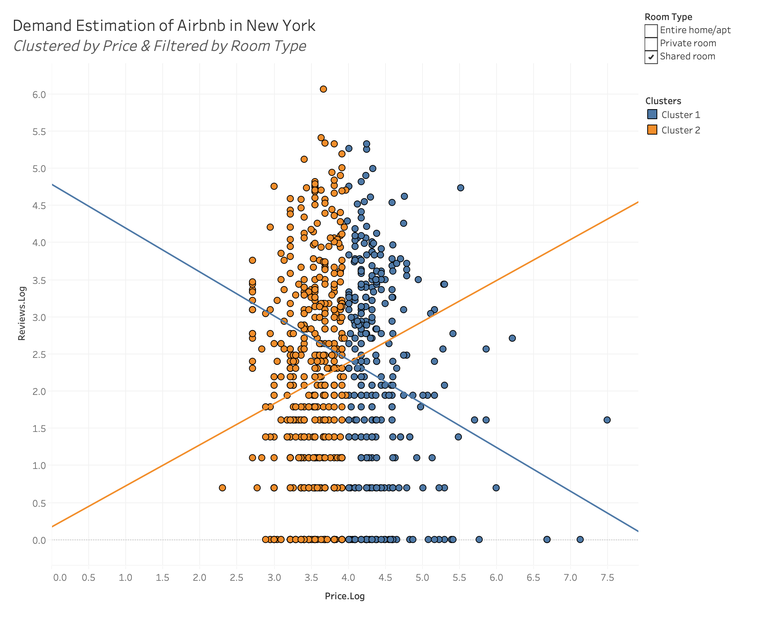
Shared Room:
Price.log below 4
As price increases by 10%, the demand of Airbnb increases by 5.527%.
Price.log above 4
As price increases by 10%, the demand of Airbnb decreases by 5.904%.

Slide 13



Q6: Time Series Analysis
The predicted number of reviews for Nov.2019 is 48,775
AirBnb has shown a steadily rising monthly number of reviews over 2009-2019
Cyclical fluctuation suggests seasonality in demand
The demand (number of reviews) generally declines from December in the previous year to a all-year low in February
The monthly number of reviews then steadily climbs to a all-year high in October (with a bump in May), possibly assisted by the influx of demand in vacation season and as weather becomes warmer

Slide 14
